Slide 1
Quick Start!
Scatterplots, Histograms, Boxplots, Bar Charts

Slide 2
The Data Science Pipeline

Slide 3
Scatterplots
plot(mpg$hwy,mpg$cty,pch = 15, main = "City MPG v. Highway MPG", ylab = "City MPG", xlab = "Highways MPG")
Known as the “pipe”!
mpg %>% ggplot(aes(x = hwy, y = cty)) + geom_point() + ggtitle("City MPG v. Highway MPG")

Slide 4
Histograms
hist(mpg$cty,col = "blue")
Serves the same purpose as the “pipe” but ggplot was developed before the pipe!
mpg %>% ggplot(aes(x = cty)) + geom_histogram()

Slide 5
Boxplots
boxplot(cty~class, data= mpg, main = "Boxplot: City MPG v. Class")
mpg %>% ggplot(aes(x = class, y = cty)) + geom_boxplot()

Slide 6
Barcharts
mpg$classFact = as.factor(mpg$class)
barplot(summary(mpg$classFact))
mpg %>% ggplot(aes(x = class)) + geom_bar() + ggtitle("Distribution of Class")

Slide 8
The ggplot Template

Slide 9
The Graphing Template
ggplot(data = <DATA>, mapping = aes(<MAPPINGS>)) + <GEOM_FUNCTION>()
ggplot(data = mpg, aes(x = hwy, y = cty)) + geom_point()
or
mpg %>% ggplot(aes(x = hwy, y = cty)) + geom_point()

Slide 10
The Graphing Template
ggplot(data = <DATA>, mapping = aes(<MAPPINGS>)) + <GEOM_FUNCTION>()
ggplot(data = mpg, aes(x = cty)) + geom_histogram()
or
mpg %>% ggplot(aes(x = cty)) + geom_histogram()

Slide 11
The Graphing Template
ggplot(data = <DATA>, mapping = aes(<MAPPINGS>)) + <GEOM_FUNCTION>()
ggplot(data = mpg, aes(x = class, y = cty)) + geom_boxplot()
or
mpg %>% ggplot(aes(x = class, y = cty)) + geom_boxplot()

Slide 12
The Graphing Template
ggplot(data = <DATA>, mapping = aes(<MAPPINGS>)) + <GEOM_FUNCTION>()
ggplot(data = mpg, aes(x = class)) + geom_bar()
or
mpg %>% ggplot(aes(x = class)) + geom_bar()

Slide 13
The Extended Graphing Template
ggplot(data = <DATA>, mapping = aes(<MAPPINGS>)) +
<GEOM_FUNCTION>() +
<LABLE_FUNCTION>() +
<FACET_FUNCTION() +
<COORD_FUNCTION() +
<THEME_FUNCTION>() +
…

Slide 15
Aesthetics | aes()
Mapping

Slide 16
aes()
Options
x and y
color
size
alpha
shape

Slide 17
aes()
Options
x and y
color
size
alpha
shape

Slide 18
aes | x and y
mpg %>% ggplot(mapping = aes(x = hwy, y = cty)) + geom_point()
mpg %>% ggplot(mapping = aes(x = hwy)) + geom_histogram()
mpg %>% ggplot(mapping = aes(x = class)) + geom_bar()

Slide 19
aes | x and y
mpg %>% + ggplot(mapping = aes(x = class, y = ..prop.., group = 1)) + geom_bar()

Slide 20
aes()
Options
x and y
color
size
alpha
shape

Slide 21
aes | color =
ggplot(data = <DATA>, mapping = aes(<MAPPINGS>)) + <GEOM_FUNCTION>()
mpg %>% ggplot(aes(x = hwy, y = cty,color = mpg$drv)) + geom_point()

Slide 22
Setting Color Manually
ggplot(data = <DATA>, mapping = aes(<MAPPINGS>)) + <GEOM_FUNCTION>(aes())
mpg %>% ggplot(aes(x = hwy, y = cty, color = "blue")) + geom_point()
mpg %>% ggplot(aes(x = hwy, y = cty)) + geom_point(color = "blue")
#note that color is not in an “aes”
# function we are setting them manually.

Slide 23
aes | color =
ggplot(data = <DATA>, mapping = aes(<MAPPINGS>)) + <GEOM_FUNCTION>()
mpg[mpg$class == "compact",] %>% ggplot(aes(x = cty, fill = drv)) + geom_histogram(color = "black")
# note now we are “mapping” fill to a variable (drv).

Slide 24
Setting Color Manually
ggplot(data = <DATA>, mapping = aes(<MAPPINGS>)) + <GEOM_FUNCTION>()
mpg[mpg$class == "compact",] %>% ggplot(aes(x = cty)) + geom_histogram(fill = "blue", color = "black")
#note that fill and color are not in an “aes” function we are setting them manually.
# We are not “mapping” variables to colors… rather just setting the color.

Slide 25
aes | color =
ggplot(data = <DATA>, mapping = aes(<MAPPINGS>)) + <GEOM_FUNCTION>()
mpg %>% ggplot(aes(x = class, y = cty,fill = drv)) + geom_boxplot(color = "blue")
# note now we are “mapping” fill to a variable (drv).

Slide 26
Setting Color Manually
ggplot(data = <DATA>, mapping = aes(<MAPPINGS>)) + <GEOM_FUNCTION>()
mpg %>% ggplot(aes(x = class, y = cty)) + geom_boxplot(color = "blue", fill = "black")
#note that fill and color are not in an “aes” function we are setting them manually.
# We are not “mapping” variables to colors… rather just setting the color.

Slide 27
aes()
Options
x and y
color
size
alpha
shape

Slide 28
aes | size =
ggplot(data = <DATA>, mapping = aes(<MAPPINGS>)) + <GEOM_FUNCTION>()
mpg %>% ggplot(aes(x = hwy, y = cty, size = mpg$displ)) + geom_point()

Slide 29
aes()
Options
x and y
color
size
alpha
shape

Slide 30
aes | alpha =
ggplot(data = <DATA>, mapping = aes(<MAPPINGS>)) + <GEOM_FUNCTION>()
mpg %>% ggplot(aes(x = hwy, y = cty, alpha = mpg$displ)) + geom_point()

Slide 31
aes()
Options
x and y
color
size
alpha
shape

Slide 32
aes | shape =
ggplot(data = <DATA>, mapping = aes(<MAPPINGS>)) + <GEOM_FUNCTION>()
mpg %>% ggplot(aes(x = hwy, y = cty, shape = mpg$drv)) + geom_point()

Slide 34
Geometric Objects | geoms

Slide 35
Geometric Objects So Far
geom_point()
geom_boxplot
geom_histogram
geom_barplot()

Slide 36
geom_smooth()
ggplot(data = mpg,mapping = aes(x = displ, y = hwy)) +
geom_point()
ggplot(data = mpg,mapping = aes(x = displ, y = hwy)) +
geom_smooth()
ggplot(data = mpg,mapping = aes(x = displ, y = hwy, linetype = drv)) +
geom_smooth()

Slide 37
You Try It!
Now analyze city versus highway mpg
GOAL: Assess if there is evidence that the relationship between city and highway mpg is different based on the drive of the car (4 wheel, front or rear.)
Create a scatter plot with just the points.
Create a plot with just the smoothed line.
Create a plot that has a different line for each level of drive(drv).
Create a plot that has the smoothed line and the points and designate the type of drive by color… in both the line and the points.
Create a plot that has the points and the smoothed line but the color designates the class of the car and the lines are differentiated by the drive variable.

Slide 39
geom You Try It Explanation

Slide 40
You Try It!
Now analyze city versus highway mpg
GOAL: Assess if there is evidence that the relationship between city and highway mpg is different based on the drive of the car (4 wheel, front or rear.)
Create a scatter plot with just the points.
Create a plot with just the smoothed line.
Create a plot that has a different line for each level of drive(drv).
Create a plot that has the smoothed line and the points and designate the type of drive by color… in both the line and the points.
Create a plot that has the points and the smoothed line but the color designates the class of the car and the lines are differentiated by the drive variable.

Slide 41
geom_smooth()
ggplot(data = mpg) + geom_point(mapping = aes(x = hwy, y = cty))
ggplot(data = mpg) + geom_smooth(mapping = aes(x = hwy, y = cty))
ggplot(data = mpg) + geom_smooth(mapping = aes(x = hwy, y = cty, linetype = drv))

Slide 42
geom_smooth()
ggplot(data = mpg, color = drv) + geom_smooth(mapping = aes(x = hwy, y = cty, linetype = drv))

Slide 43
geom_smooth()
ggplot(data = mpg) +
geom_point() +
geom_smooth(mapping = aes(x = hwy, y = cty, linetype = drv, color = drv))
# The aes() is just for geom_smooth()

Slide 44
geom_smooth()
#Global aes() ... one aes that applies to all layers
ggplot(data = mpg, mapping = aes(x = hwy, y = cty, linetype = drv, color = drv)) +
geom_point() +
geom_smooth()

Slide 45
geom_smooth()
#Individual aes() …. an aesthetic for each layer
ggplot(data = mpg) +
geom_point(mapping = aes(x = hwy, y = cty, color = class)) +
geom_smooth(mapping = aes(x = hwy, y = cty, linetype = drv, color = drv))

Slide 46
Response to Goal
GOAL: Assess if there is evidence that the relationship between city and highway mpg is different based on the drive of the car (4 wheel, front or rear.)
Judging from the Loess curves, there is not sufficient evidence to suggest the relationship between highway and city mpg is different based on the drive of the car.

Slide 48
Labels

Slide 49
The Extended Graphing Template
ggplot(data = <DATA>, mapping = aes(<MAPPINGS>)) +
<GEOM_FUNCTION>() +
<LABLE_FUNCTION>()
ggplot(data = mpg, aes(x = class, y = cty)) + geom_boxplot() + ggtitle("Boxplot of City MPG v. Class") + xlab("Class") + ylab("City MPG")

Slide 50
The Extended Graphing Template
ggplot(data = <DATA>, mapping = aes(<MAPPINGS>)) +
<GEOM_FUNCTION>() +
<LABLE_FUNCTION>()
#Individual aes() …. an aesthetic for each layer
ggplot(data = mpg) +
geom_point(mapping = aes(x = hwy, y = cty, color = class)) +
geom_smooth(mapping = aes(x = hwy, y = cty, linetype = drv, color = drv)) + ggtitle("City v. Highway MPG") + xlab("Highway MPG") + ylab("City MPG")

Slide 52
Facets

Slide 53
The Extended Graphing Template
ggplot(data = <DATA>, mapping = aes(<MAPPINGS>)) +
<GEOM_FUNCTION>() +
<LABLE_FUNCTION>() +
<FACET_FUNCTION() +
…

Slide 54
facet_wrap()
#Individual aes() …. an aesthetic for each layer
ggplot(data = mpg) +
geom_point(mapping = aes(x = hwy, y = cty, color = class)) +
geom_smooth(mapping = aes(x = hwy, y = cty, linetype = drv, color = drv))

Slide 55
facet_wrap()
ggplot(data = mpg) +
geom_point(mapping = aes(x = hwy, y = cty, color = class)) +
geom_smooth(mapping = aes(x = hwy, y = cty, linetype = drv)) +
facet_wrap(~class)

Slide 56
facet_wrap()
ggplot(data = mpg) +
geom_point(mapping = aes(x = hwy, y = cty, color = drv)) +
geom_smooth(mapping = aes(x = hwy, y = cty, linetype = drv)) +
facet_wrap(~class)

Slide 57
facet_grid()
ggplot(data = mpg) +
geom_point(mapping = aes(x = hwy, y = cty, color = drv)) +
geom_smooth(mapping = aes(x = hwy, y = cty, linetype = drv)) +
facet_grid(drv~class)

Slide 58
facet_grid(): Other geoms
ggplot(data = mpg, aes(fill = drv)) +
geom_histogram(mapping = aes(x = cty)) +
facet_grid(drv~class)

Slide 60
Statistical Transformations
Bar Charts!

Slide 61
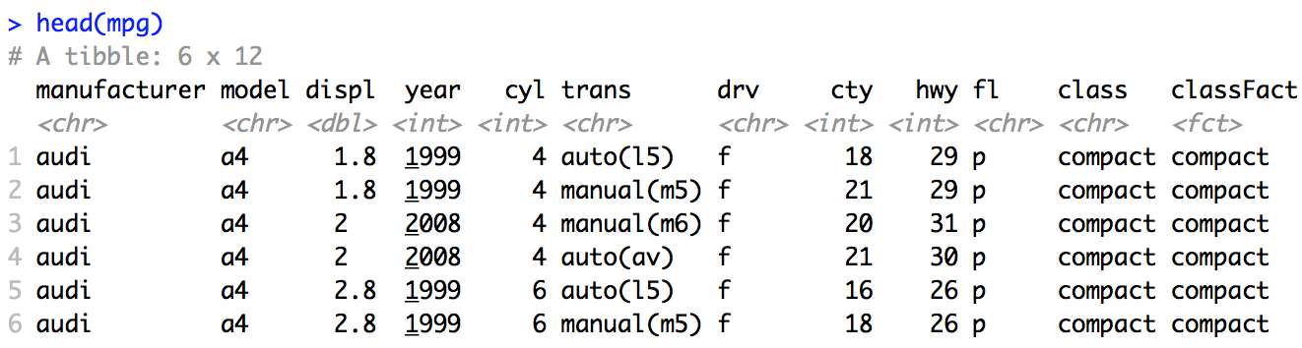
Statistical Transformations/Derived Features
The count and values of the smoothed line are not explicitly part of the data set.
They are derived from the data … in ggplot2 we call these Statistical Transformations.

Slide 62
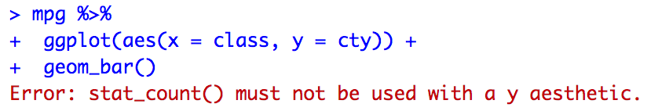
A Closer Look at Bar Charts
mpg %>%
ggplot(aes(x = class)) +
geom_bar(stat = "count")
mpg %>%
ggplot(aes(x = class, y = cty)) +
geom_bar()
mpg %>%
ggplot(aes(x = class, y = cty)) +
geom_bar(stat = “identity”)
Notes:
This slide is paired with an Rstudio demo:
mpg %>% ggplot(aes(x = class)) + geom_bar(stat = "count")
mpg %>% ggplot(aes(x = class, y = cty)) + geom_bar()
mpg %>% ggplot(aes(x = class, y = cty)) + geom_bar(stat = “identity”)

Slide 64
Positions

Slide 65
Position = {Stack, Fill, Dodge}
mpg %>% ggplot(mapping = aes(x = class, fill = drv)) + geom_bar(position = "stack")
mpg %>% ggplot(mapping = aes(x = class, fill = drv)) + geom_bar()

Slide 66
Position = {Stack, Fill, Dodge}
mpg %>% ggplot(mapping = aes(x = class, fill = drv)) + geom_bar(position = "dodge")

Slide 67
Position = {Stack, Fill, Dodge}
mpg %>% ggplot(mapping = aes(x = class, fill = drv)) + geom_bar(position = "fill")

Slide 68
Position = jitter
mpg %>%
+ ggplot(mapping = aes(x = hwy, y = cty)) +
+ geom_point()
mpg %>%
+ ggplot(mapping = aes(x = hwy, y = cty)) +
+ geom_point(position = "jitter")

Slide 70
Other Coordinate Systems

Slide 71
The Extended Graphing Template
ggplot(data = <DATA>, mapping = aes(<MAPPINGS>)) +
<GEOM_FUNCTION>() +
<LABLE_FUNCTION>() +
<FACET_FUNCTION() +
<COORD_FUNCTION() +
…

Slide 72
coord_flip
mpg %>% ggplot(mapping = aes(x = class, fill = class)) + geom_bar()

Slide 73
coord_flip
mpg %>% + ggplot(mapping = aes(x = class, fill = class)) + geom_bar() + coord_flip()

Slide 74
coord_polar
mpg %>% + ggplot(mapping = aes(x = class, fill = class)) + geom_bar() + coord_polar()

Slide 76
Other Coordinate Systems | Maps

Slide 77
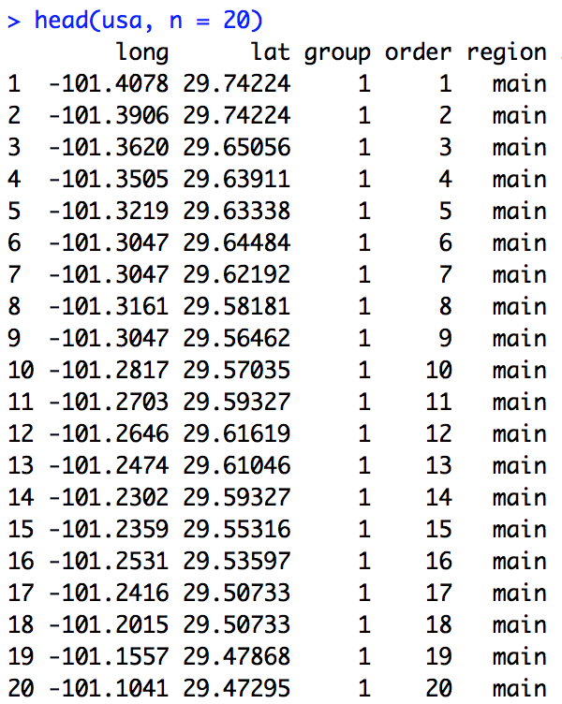
coord_quickmap and map_data
install.packages(”maps")
library(maps)
usa = map_data("usa")
p <- ggplot() +
geom_polygon(data = usa, aes(x = long, y = lat, group = group), fill = "blue", color = "black") +
coord_quickmap()
usa = map_data("usa")
https://eriqande.github.io/rep-res-eeb-2017/map-making-in-R.html

Slide 78
coord_quickmap and map_data
usa = map_data("usa")
p <- ggplot() +
geom_polygon(data = usa, aes(x = long, y = lat, group = group), fill = "blue", color = "black") +
coord_quickmap()
#Dallas Coords
Dallas <- tibble(
long = c(-96.7970),
lat = c(32.7767),
names = c("Dallas"))
p + geom_point(data = Dallas, aes(x = long, y = lat), shape = 21, color = "black", fill = "yellow", size = 5) +
geom_text(data = Dallas, aes(x = long, y = lat, label = names), hjust = 0, nudge_x = 1, color = "white")
https://eriqande.github.io/rep-res-eeb-2017/map-making-in-R.html

Slide 79
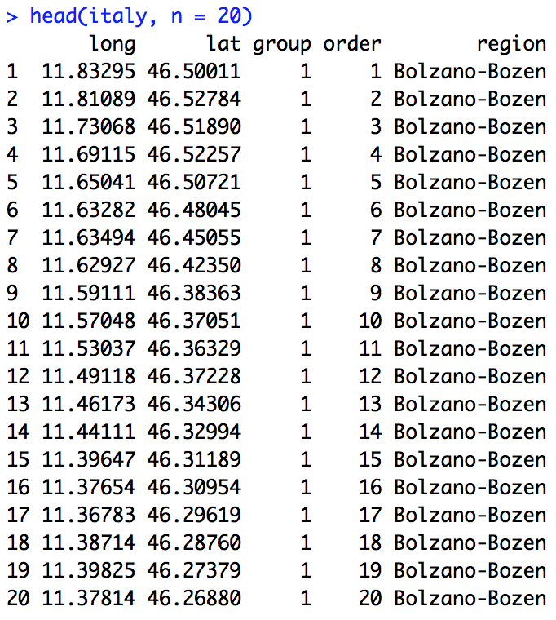
coord_quickmap and map_data
italy = map_data("italy")
ggplot(italy, aes(long,lat, group = group)) +
geom_polygon(fill = "white", color = "black") +
coord_quickmap()
Notes:
Plot map of US with states…. check out ?map_data

Slide 81
theme()

Slide 82
The Extended Graphing Template
ggplot(data = <DATA>, mapping = aes(<MAPPINGS>)) +
<GEOM_FUNCTION>() +
<LABLE_FUNCTION>() +
<FACET_FUNCTION() +
<COORD_FUNCTION() +
<THEME_FUNCTION>() +
…

Slide 83
ggthemes()
Themes are a way to format your plotting area very quickly and often to a standard that mimics popular magazines, websites, software, etc.
install.package(“ggthemes”)
library(ggthemes)

Slide 84
Excel
ggplot(mapping = aes(x = hwy, y = cty)) + geom_point(position = "jitter") + ggtitle("City MPG v. Highway MPG") + theme_excel()

Slide 85
Excel
mpg %>%
+ ggplot(mapping = aes(x = class, fill = class)) + geom_bar() + theme_excel()

Slide 86
The Economist

Slide 87
The Economist
ggplot(mapping = aes(x = hwy, y = cty)) +
geom_point(position = "jitter") + ggtitle("City MPG v. Highway MPG") +
theme_economist()

Slide 88
The Economist
mpg %>%
+ ggplot(mapping = aes(x = class)) + geom_bar() + theme_economist()

Slide 89
FiveThirtyEight
https://fivethirtyeight.com/features/lionel-messi-is-impossible/

Slide 90
FiveThirtyEight
ggplot(mapping = aes(x = hwy, y = cty)) +
geom_point(position = "jitter") +
ggtitle("City MPG v. Highway MPG") +
theme_fivethirtyeight()

Slide 91
FiveThirtyEight
mpg %>% +
ggplot(mapping = aes(x = class, fill = class)) +
geom_bar() + ggtitle(“Vehicle Class”) +
theme_fivethirtyeight()

Slide 92
Additional Themes!
theme_base theme_calc theme_economist theme_excel theme_excel_ theme_few theme_fivethirtyeight theme_foundation theme_gdocs theme_hc | theme_igray theme_map theme_pander theme_par theme_solarized theme_solid theme_stata theme_tufte theme_wsj

Slide 93
Additional Theme Resources!
http://www.sthda.com/english/wiki/ggplot2-themes-and-background-colors-the-3-elements
https://jrnold.github.io/ggthemes/
https://www.r-bloggers.com/custom-themes-in-ggplot2/
https://cran.r-project.org/web/packages/ggthemes/ggthemes.pdf

Slide 95
Interactive Plots | plotly

Slide 96
mpg with plotly
You have to see this to believe it!
So useful…
and so simple!
install.packages(”plotly”)
library(plotly)
p = mpg %>% ggplot(mapping = aes(x = hwy, y = cty)) + geom_point(position = "jitter") + ggtitle("City MPG v. Highway MPG") + theme_excel()
ggplotly(p)

Slide 97
mpg with plotly
You have to see this to believe it!
So useful…
and so simple!
p = mpg[mpg$class == "compact",] %>% ggplot(aes(x = cty, fill = drv)) + geom_histogram(color = "blue")
ggplotly(p)

Slide 98
Student Data with plotly
You have to see this to believe it!
So useful…
and so simple!
#generating the data age = c(22,21,24,19,20,23) yrs_math_ed = c(4,5,2,5,3,5) names = c("Mary","Martha","Kim","Kristen","Amy","Sam") subject = c("English","Math","Sociology","Math","Music","Dance") df3 = data.frame(Age = age, Years = yrs_math_ed, Name = names, Subject = subject)
#plotting code p = df3 %>% ggplot(aes(x = Name, y = Years)) + geom_bar(stat = "identity") + ggtitle("Distribution of Class")
#enabling interactive piece ggplotly(p)

Slide 100
#3D Plots | plotly

Slide 101
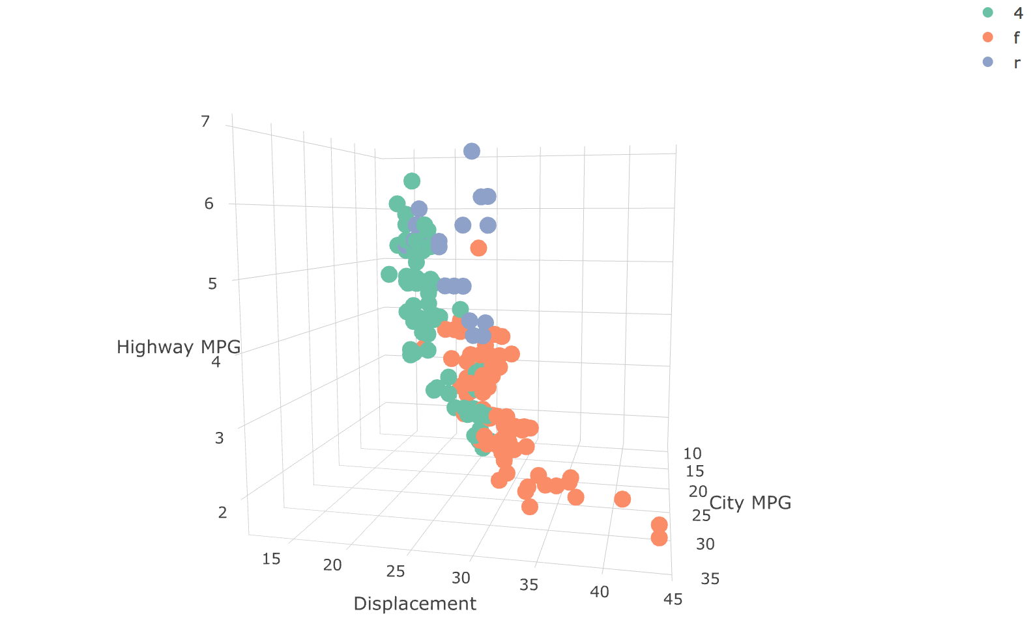
mpg with plotly
You really have to see this!
p <- plot_ly(mpg, x = ~cty, y = ~hwy, z = ~displ, color = ~drv) %>%
add_markers() %>%
layout(scene = list(xaxis = list(title = 'City MPG'), yaxis = list(title = 'Displacement'), zaxis = list(title = 'Highway MPG')))

Slide 102
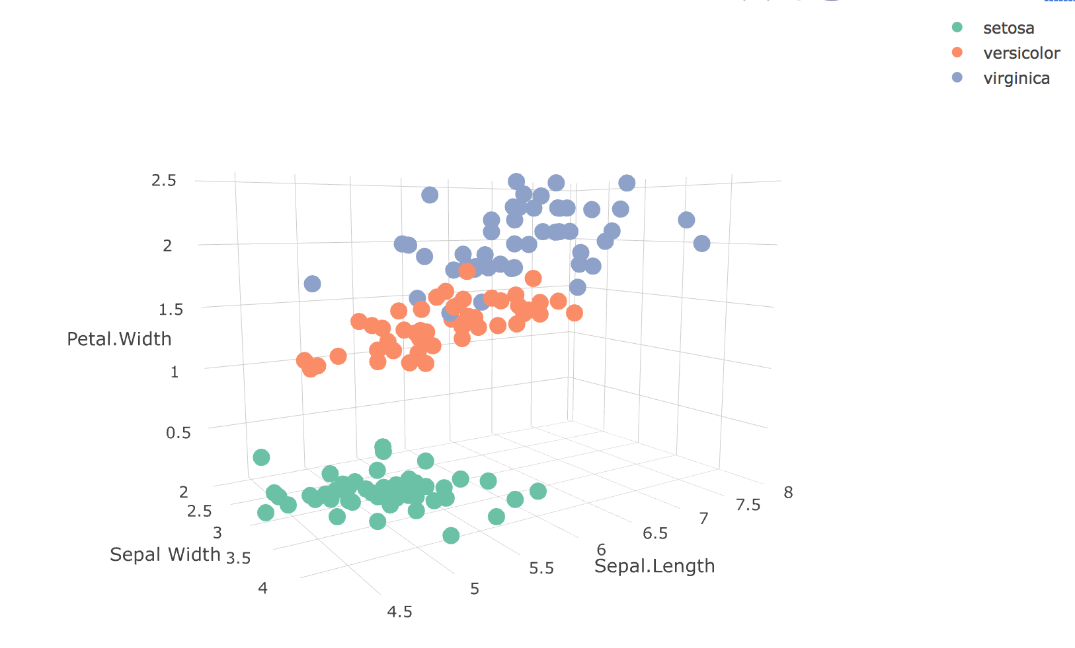
iris with plotly
You really have to see this!
p <- plot_ly(iris, x = ~Sepal.Width, y = ~Sepal.Length, z = ~Petal.Width, color = ~Species) %>%
add_markers() %>%
layout(scene = list(xaxis = list(title = 'Sepal Width'), yaxis = list(title = 'Sepal.Length'), zaxis = list(title = 'Petal.Width')))

